Slide 1
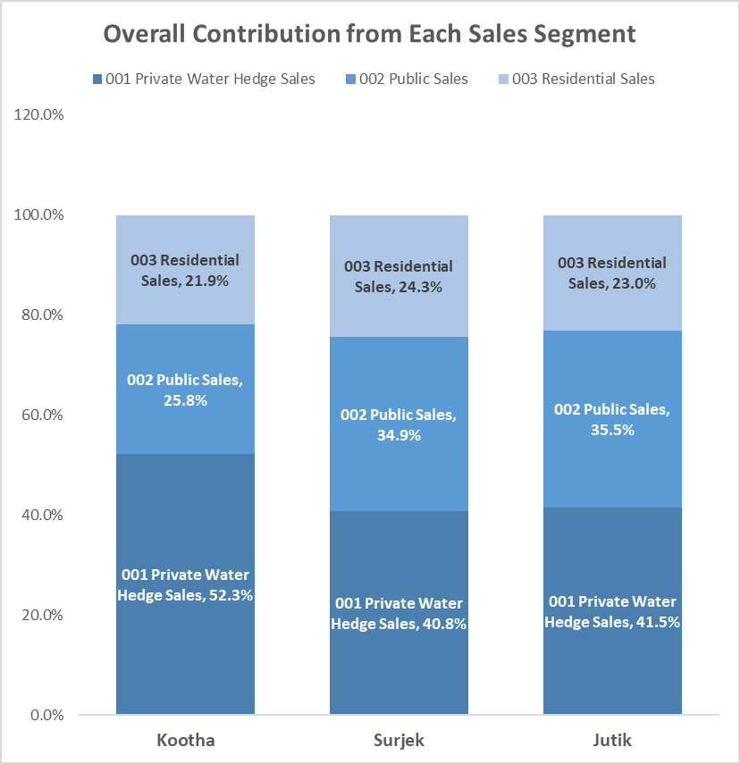
Segmentation of the revenues by unit, reveals that of the three (3) customer segments, 001 Private Water Hedge Sales are the most popular, followed by 002 Public Sales ($147M) and lastly 003 Residential Sales ($102.5M).
Notes:
PROMPT: The first slide we want to show is our segmented analysis of the revenues for each customer group.
On this slide, we would like you to show the following: A) In a Stacked Column Chart, please include a chart which shows the % that is contributed by each Sales Segment per Unit (Kootha, Surjek and Jutik)
Remember, when you show these charts, it should clearly show which segments generate the most revenues
Hint: The Chart you’ve created for the Revenues Tab, Q3, may be helpful.
I have some questions here. It seems like we need to create brand new data charts and corresponding graphics because the information that is being requested for this slide was not created in the Revenue Analysis tab of the spreadsheet. What’s even more confusing is that this certainly isn’t related to question 3, but question 4. Again, even under question 4 we were not asked to provide totals of each customer segment (they’re broken up by unit, so we don’t have any totals. I also feel like the headlines for these slides don’t reflect the specific things that you can see in the graphic chart that the slide is asking us to input. Am I missing something/overthinking this? The headlines and graphics don’t make sense to me in terms of interpreting the data provided in the graphic…

Slide 2
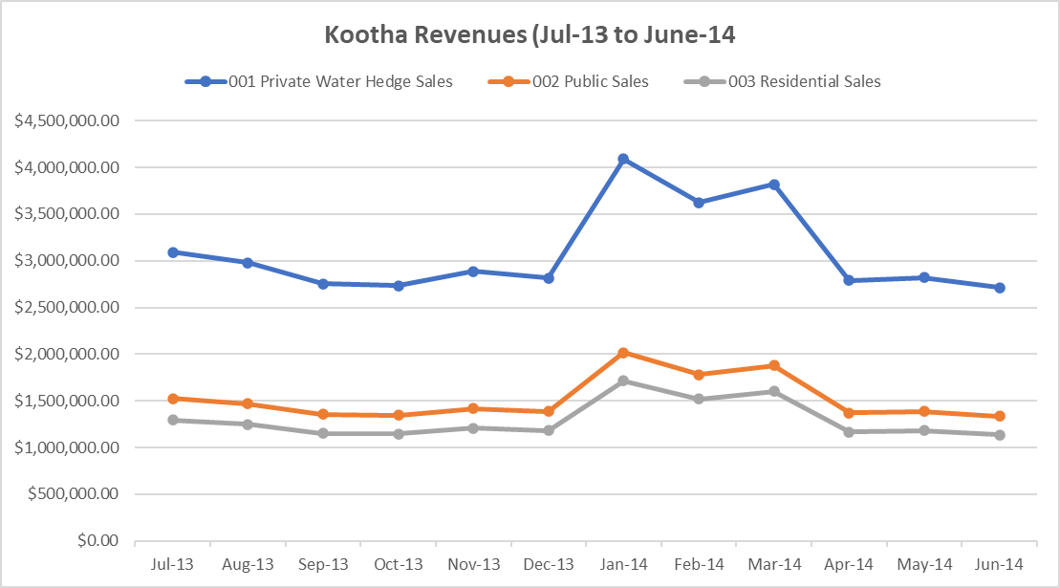
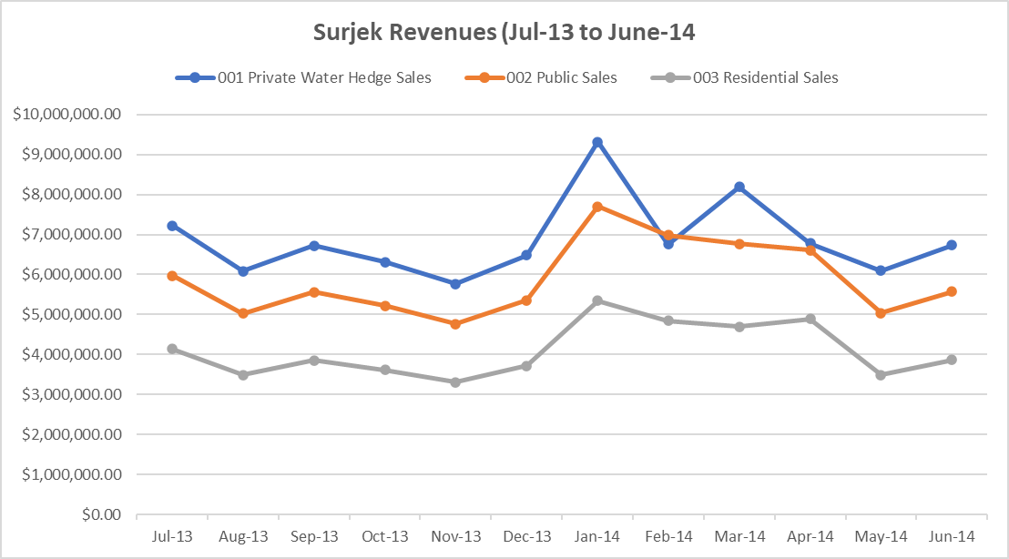
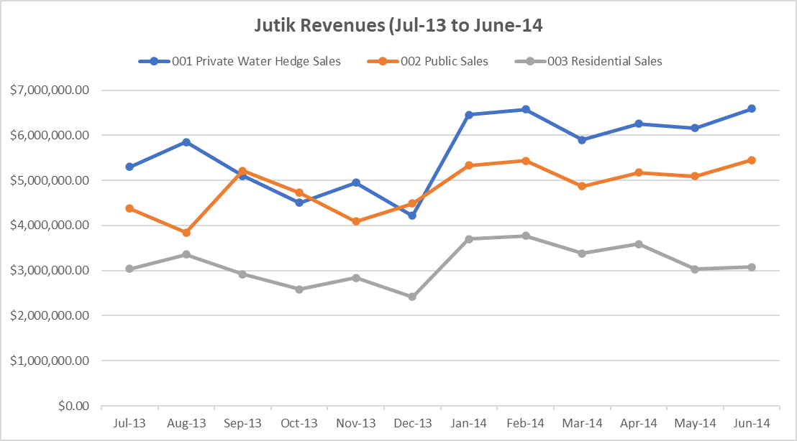
Of the ($437M)¹ in Revenue Sales over the July-2013 to June-2014 Period, Surjek provides close to 50% of Sales Volumes ($202M), with Jutik providing 37.5% ($164M) and Kootha ($71M) providing the remaining.
Note: This refers to the Total Sales for all 3 Units (Kootha, Surjek and Jutik)
Notes:
PROMPT: In the previous slide we’ve provided a ‘macro’ view. We now want to compliment this with a ‘micro view’ of the revenues analysis. A micro view by default means we want to show the Units which went into the macro calculation; in this case, it would be the individual revenue trends for Kootha, Surjek and Jutik.
On this slide, we would like you to show the following: A) Create three chart(s), which show the Sales Revenues for each of the three customer segments for Kootha, Surjek and Jutik over the June-2013 to July-2014 Period.
Hint: The Chart you’ve created for the Revenues Tab, Q2, may be helpful. We’ve included an example chart on the right!
had question number to reference is off – this should be Q3 on the Revenues tab. Also again not sure how the heading of this slide relates in any way to the graphics because I definitely had to reference new sets of data that I calculated on the spreadsheet (data that wasn’t originally asked to be provided on the spreadsheet).

Slide 3
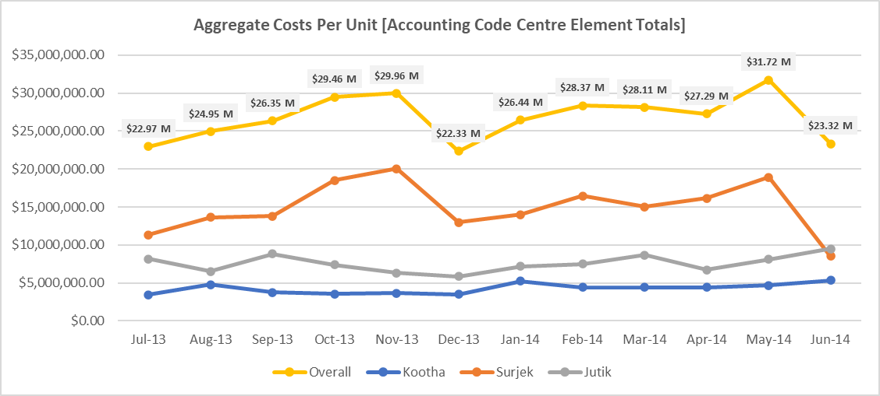
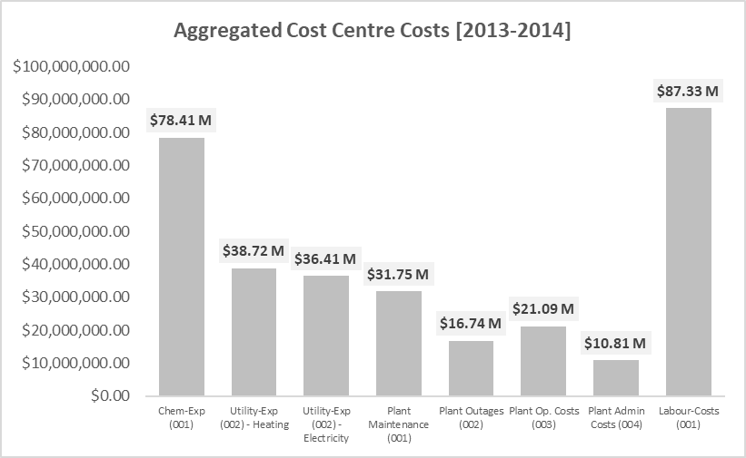
Targeted Expense Analysis reveals an interesting trend; Overall Costs sharply increase from December, with Surjek contributing $179M (56%) towards the overall cost-base.
Notes:
PROMPT: We are now going to move to the expenses side of the story. Similar to before, we start with a macro-view of the expenses;
Of the three units – which of these have clearly contributed the most to costs? Secondly, what does the aggregate costs look like when grouped by cost centre?
On this slide, we would like you to show the following:
A) Create a chart which shows the Aggregate Costs on an individual-unit basis (i.e. Kootha, Surjek and Jutik should all be on the same chart)
B) Create a secondary chart which shows the aggregate costs for all units shown by cost centre
Hint: The Chart you’ve created for the Expenses Tab, Q5, may be helpful.

Slide 4
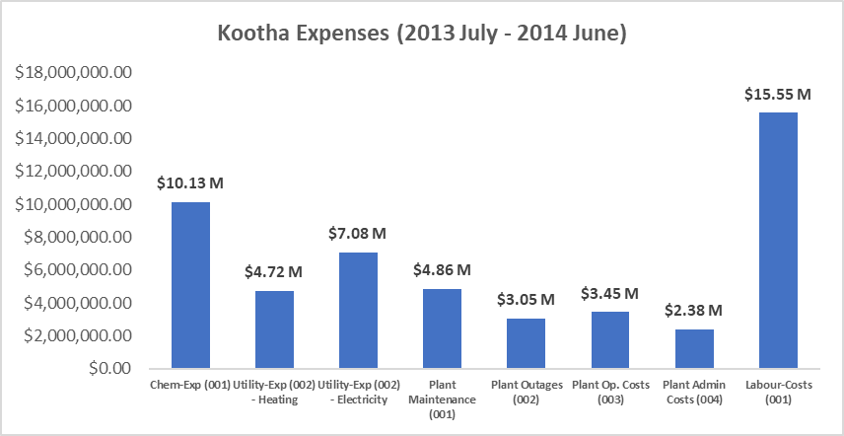
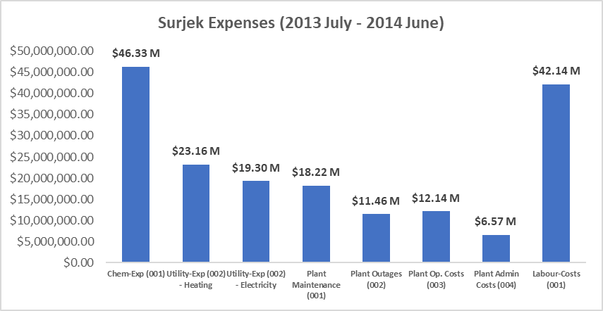
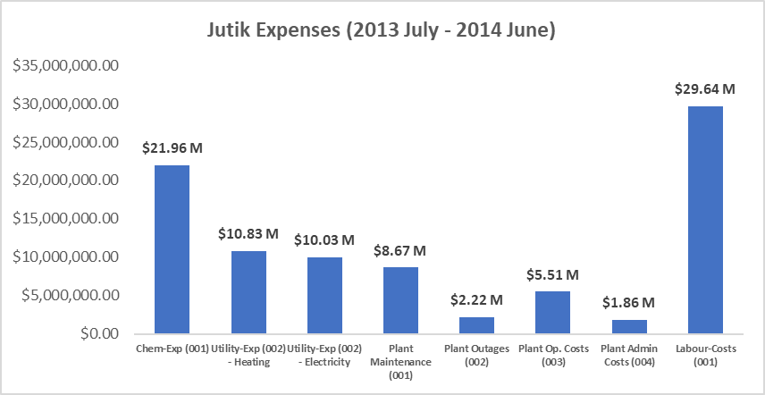
Further analysis singles-out Surjek with $179M (56%) worth of expenses, contrasted to a much lower spend from Kootha ($51 M) and Jutik ($91M), largely due to lower Chemical and Labour Expenditure.
Notes:
PROMPT: We’ve now told the expenses story from a macro view, it’s time we focus on the story now from a micro view.
This means creating three charts (one for each unit) which showcases the aggregate costs per cost centre group.
On this slide, we would like you to show the following:
A) Create a chart which shows the Aggregate Costs on an individual-unit basis with expenses grouped by cost centre (i.e. Kootha, Surjek and Jutik should all be on separate charts)
Hint: The Chart you’ve created for the Expenses Tab, Q6, may be helpful.

Slide 5
Drilling-down to the cost-element level, reveals an indicative relationship between water production and chemical expenditure with this being particularly pronounced for the Surjek Unit which coincidentally has the highest rate of water production.
Notes:
PROMPT: We’ve now identified that a particular cost group (chemicals) is responsible for a significant portion of the costs. It’s time for us to drill-down a bit further and illustrate this story with a graphic. We want to show-case the Chemical Expenditure for each month, trended against the Water Production.
This will let us know whether or not there is a relationship between Chemical Expenditure and Water Production Volumes.
On this slide, we would like you to show the following:
A) Create a chart (similar to the example shown on the right) which shows the Monthly Chemical Expenditure Per Month, versus Monthly Water Production for each of the three Units (Kootha, Surjek and Jutik).
Hint: The Chart you’ve created for the Expenses Tab, Q7, may be helpful.

Slide 6
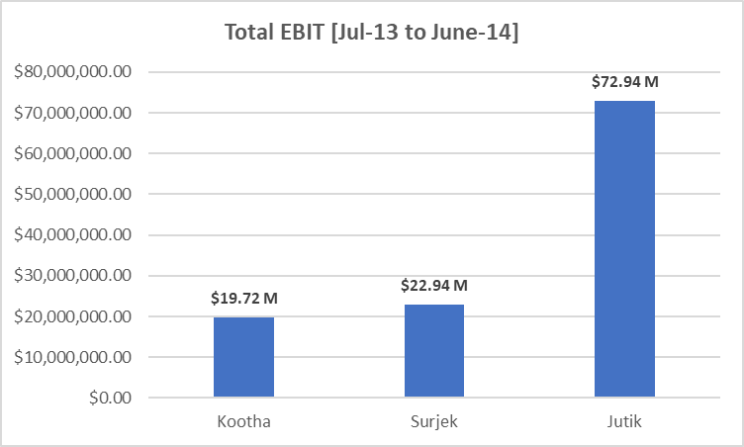
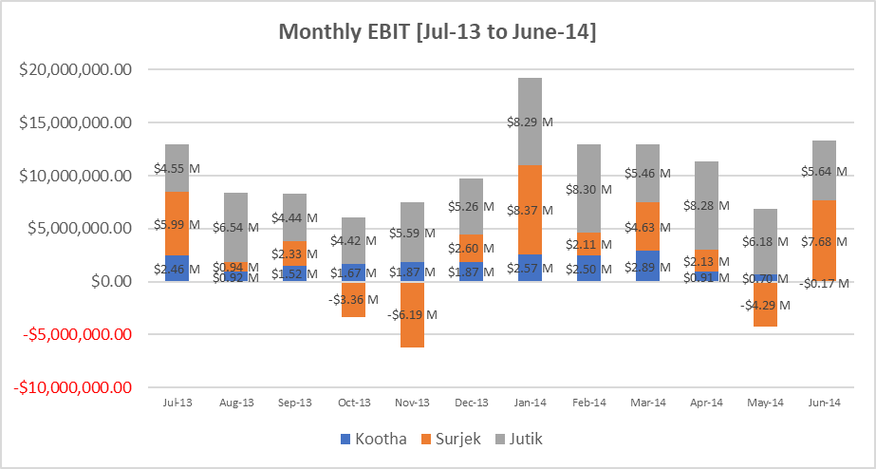
Concluding our analysis, Jutik has the highest overall EBIT contributions ($72.94M), followed by Surjek ($22.94M) , and lastly Kootha ($19.72M). However, from an EBIT Margin (%) perspective, Kootha has a higher margin than that of Surjek indicative of a lower revenue-to-expense ratio.¹
Note:¹ We can clearly see for Surjek over the October, November and May Periods – expenses were far higher than revenues which contributed to this lower revenue-to-expense ratio.
Notes:
PROMPT: We’re now at the final slide for our story. We’ve shown the revenues, we’ve unpacked the expenditures and now, finally, we’re going to close out the analysis by showing the overall EBIT for each unit. In this Slide, we want to convey to the audience which Unit(s) bring in the most EBIT from both a EBIT ($) perspective as well as highlighting the EBIT Margin – Do any units have lower revenues than another unit, but higher EBIT Margins, indicating they are most cost effective?
It’s time for us to close out this story below: A) Create two charts which highlight the overall EBIT per Unit (i.e. Kootha, Surjek and Jutik), as well as a second chart which shows the EBIT Trends for each Unit on a monthly basis (June-13 to June-14).
Hint: The Chart you’ve created for the Expenses Tab, Q9, may be helpful.

